Slide 1
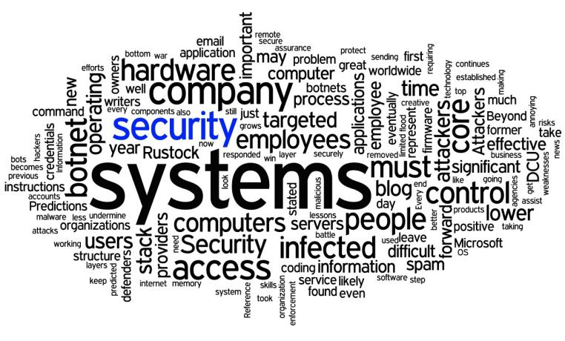
Risk Management
School of Computer Science and IT JAIN (DEEMED-TO-BE UNIVERSITY) Department of Bachelor of Computer Applications
Module 3

Slide 2

Agenda
Introduction
Importance of Risk management
Phases of Risk Management
Risk Management Process
Risk Analysis methods.
Risk-IT Framework of ISACA

Slide 3
Introduction
The term risk refers to the concept that an action or choice can result in a losing situation.
Risk management is the total process used to identify, control, and minimize the impact of uncertain events.
Risks can come from various sources including uncertainty in financial markets, threats from project failures (at any phase in design, development, production, or sustainment life-cycles), legal liabilities, credit risk, accidents, natural causes and disasters, deliberate attack from an adversary, or events of uncertain or unpredictable root causes.
The objective of the risk management program is to reduce the risk of performing some activity or function to an acceptable level.

Slide 4
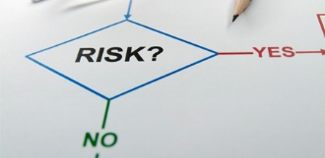
What is Risk Management?
The formal process of identifying and controlling the risks facing an organization is called risk management. It is the probability of an undesired event causing damage to an asset.
(Or)
The process of identifying Vulnerability in an organization information system & taking carefully respond to CIA.

Slide 5
Components of Risk management
Examination and Documentation of the security posture of an
organization’s information technology and the risks it faces.
Risk Identification
Risk Assessment
Determination of the extent to which the organization’s
information assets are exposed or at risk.
Application of controls to reduce the risk to an organization’s
data and information system.
Risk Control

Slide 6
RM & SDLC
Effective risk management must be totally integrated into the organization’s system development life cycle.
The typical SDLC has five phases,
Analysis
Design
Construction
Test
Maintenance

Slide 7
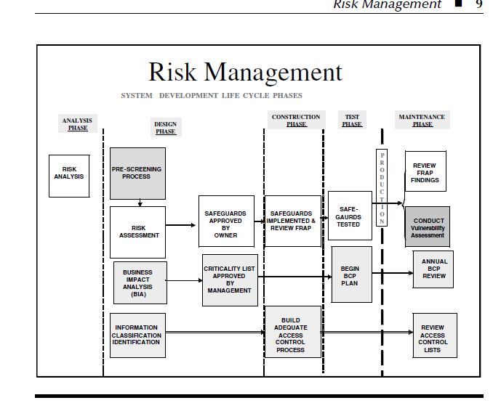
RM & SDLC

Slide 8
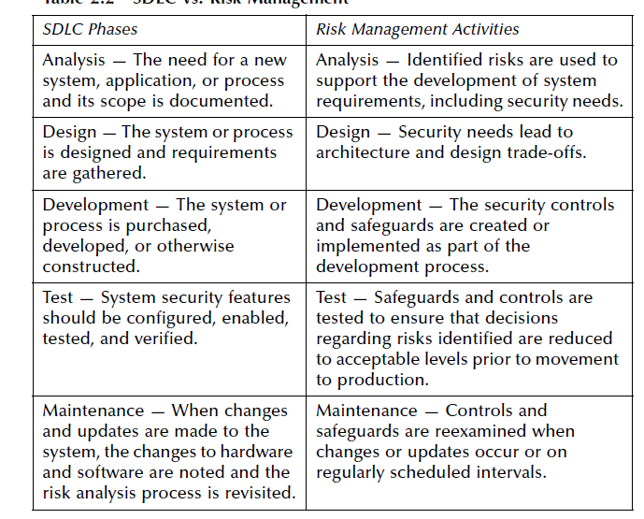
RM & SDLC

Slide 9
General Sun Tzu Wu Said
If you know your enemy and know yourself, you need not fear the result of a hundred battles.
If you know yourself but not the enemy, for every victory gained you will also suffer a defeat.
If you know nothing the enemy nor yourself, you will suffer in every battle.

Slide 10
Context
Know Yourself -:
Identify, Examine & Understand the information systems.
To protect assets, you must understand what they are?
The policies, Education and training programs, and technologies.
Know Enemy -:
Identifying, Examining & Understanding the threats facing the organization.

Slide 11
Roles played by the different communities of interest in org :
Information Security Specialist :
Best understand threats & attacks that introduce risk into the org.
Take an leadership role in addressing risk.
Management & Users : Management ensure resources are allocated to IS & IT.
Information Technology Specialist: Must build secure system & operate them safely.

Slide 12
Accountability of Risk management
Evaluate Risk controls - Evaluation
Determine which controls are effective – Cost Effective
Assist in acquiring or installing needed controls - Assisting
Ensure that controls remain effective - Monitoring

Slide 13
Risk Management Process
Inventory Review - Assets
Identification - Vulnerability
Controls – Strategies Reviewed
Cost effective – Measuring the Strategies
Monitoring – Managing on going process

Slide 14
Risk Identification Process
Step 1: IT professionals or employees they should know about their org. information assets through identifying, classifying and prioritize them
Step 2: Once Assets are identified , Then threat identification process is undertaken
Step 3: Each assets are examined to identify vulnerabilities
Step 4: If found, Controls are identified and assessed to limit possible losses

Slide 15
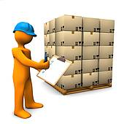

Risk Identification
Identify & inventory assets
Classify & prioritize assets
Identify & prioritize threats

Slide 16
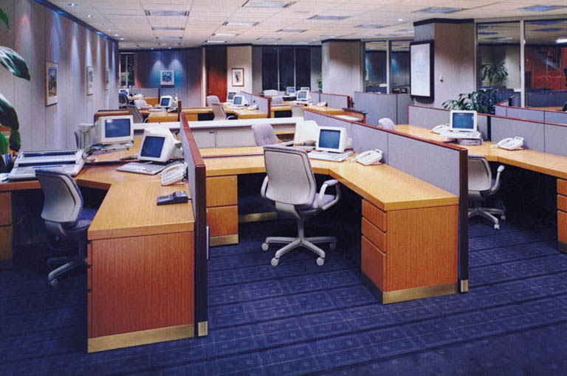
Asser identification and inventory

Slide 17
Asset identification
People
Procedure
Data
Software
Hardware

Slide 18
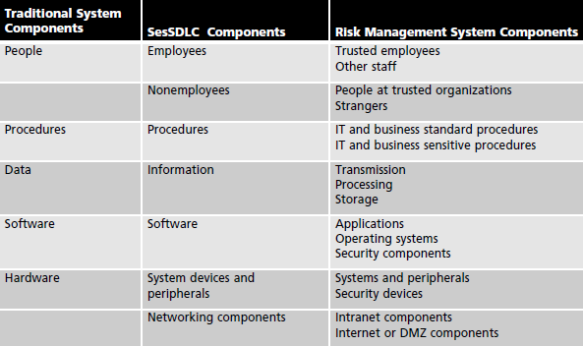
Asset identification
Identify the organizations’ information assets—that is, identify, classify, and prioritize them.
Risk identification is an iterative process and begins with the enumeration of assets, including all of the elements of an organization’s system, such as people, procedures, data and information, software, hardware and networking elements

Slide 19
Asset Classifications
Identifying human resources, documentation, and data assets is more difficult than identifying hardware and software assets.
People with knowledge, experience, and judgment should be assigned the task.
Consider the following asset attributes:
People: Position name/number/ID (avoid names and stick to identifying positions, roles, or functions); supervisor; security clearance level; special skills
Procedures: Description; intended purpose; relationship to software, hardware, and networking elements; storage location for reference; storage location for update
Data: Classification; owner, creator, and manager; size of data structure; data structure used (sequential or relational); online or offline; location; backup procedures employed

Slide 20
Asset Classification
H/w, S/w & Network :
Name: Use the most common device or program name. Organizations may have several names for the same product.
IP address: This can be a useful identifier for network devices and servers, but does not usually apply to software.
Media access control (MAC) address: MAC addresses are sometimes called electronic serial numbers or hardware addresses.
Serial number, Manufacturer name, Software version, update revision, Physical location, Logical location, Controlling entity etc.,

Slide 21
Data Classification
Public: Information for general public dissemination, such as an advertisement or public release.
For Official Use Only: Information that is not particularly sensitive, but not for public release, such as internal communications.
Sensitive: Information important to the business that could embarrass the company or cause loss of market share if revealed.
A data classification scheme generally requires a corresponding personnel security clearance structure, which determines the level of information individuals are authorized to view, based on what they need to know.
Fundamental Principle is NEED TO KNOW basis

Slide 22
Info asset valuation – Prioritize Assets
Based on Questionnaire assists in developing the weighting criteria :
Which information asset is the most critical to the success of the organization?
Which information asset generates the most revenue?
Which information asset would be the most expensive to replace?
Which information asset would be the most expensive to protect?
Which information asset would most expose the company to liability or embarrassment if revealed?

Slide 23
Threat Identification
A threat source is defined as any circumstance or event with the potential to cause harm to the asset under review.
Create as complete a list of threat sources as possible.
Typically, there are three major categories of threat sources:
Natural threats — Floods, earthquakes, cyclone, landslides, avalanches, electrical storms, and other such events
Human threats —Events that are either enabled by or caused by human beings, such as unintentional acts (errors and omissions) or deliberate acts (fraud, malicious software, unauthorized access). Statistically, the threat that causes the largest loss to information resources remains human errors and omissions
Environmental threats — Long-term power outages, pollution, chemical spills, liquid leakage.
Developing checklists, examine historical data and brainstorming with stakeholders are some ways of identifying threats.

Slide 24
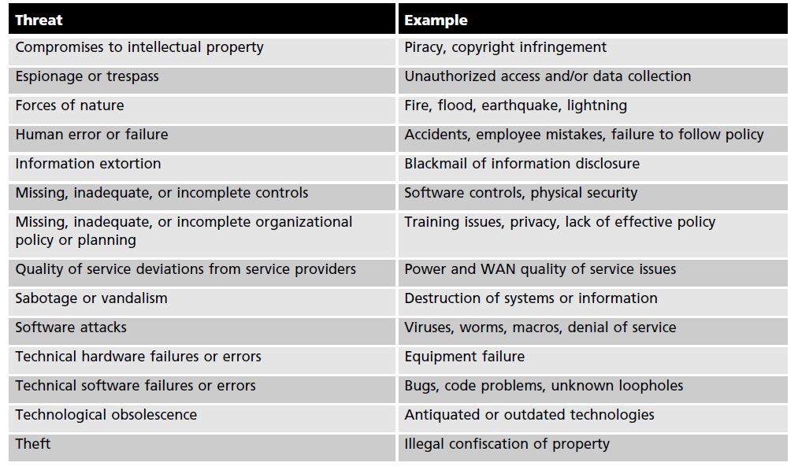
Categories of Threats to info security

Slide 25
Identify and Prioritize threats
Address each threat with a few basic questions, as follows:
Which threats present a danger to an organization’s assets in the given environment?
Which threat represent most danger to the organizations information?
How much would it cost to recover from a successful attack?
Which of the threats would require the greatest expenditure to prevent?

Slide 26
Process of Vulnerability identification
Create a list of Vulnerabilities for each information asset.
Groups of people work iteratively in a series of sessions give best result.
At the end of Identification process, you have a list of assets and their vulnerabilities.
Threat Possible Vulnerabilities
Deliberate S/W attacks IP is vulnerable to DOS.
Acts of Human error or failure Employee may cause outage
Technical S/W failures or Errors Vendor supplied routing software could fail

Slide 27

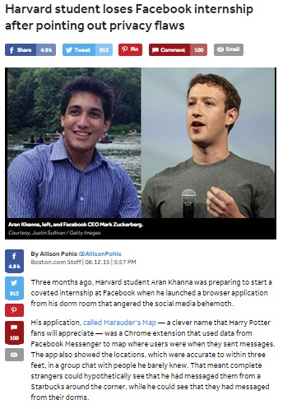
Tech News

Slide 28
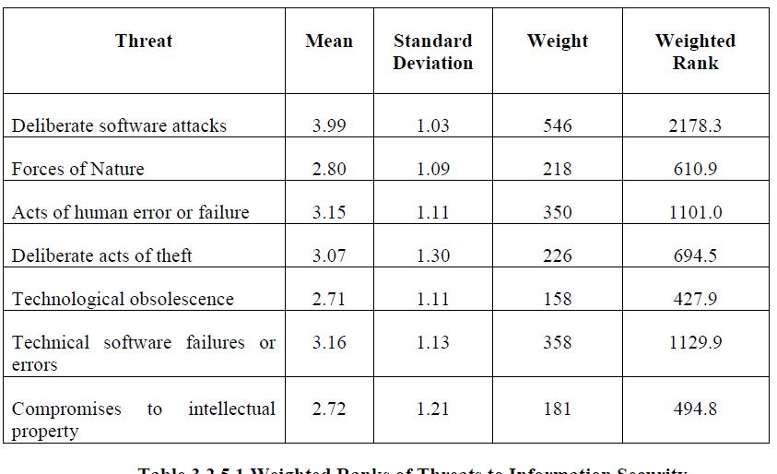
Output of Level 1 - Worksheet

Slide 29

Risk Assessment
Identify vulnerabilities between assets & threat
Identify & quantify asset exposure

Slide 30
Process of Risk Assessment
After identifying all the threats related to information assets.
Ranked vulnerability risk worksheet is the initial working document for the next step in the risk management process
Assessment
Controlling risk
Valuation of information Asset:
Information asset classification worksheet
Weighted criteria analysis worksheet
Ranked vulnerability risk worksheet

Slide 31
Risk Identification Estimate Factors – NIST Standard
Likelihood
Value of information assets
Percentage of risk mitigated
Uncertainty

Slide 32
Factors- National Institute of Standards & Technology (NIST) gives some standards
Likelihood : Probability of specific vulnerability within an organization will be successfully attacked
0.1 = Low
1.0 = high
E.g. : No. of network attacks can be forecast based on how many network address the organization has assigned.

Slide 33
Risk Determination
Risk = [ ( Likelihood of vulnerability occurrence ) X (Value of information Asset )] -- ( % of risk mitigated by current controls) + uncertainty of current knowledge of the Vulnerability.
For the purpose of relative risk assessment, risk equals:
Likelihood of vulnerability occurrence TIMES value (or impact)
MINUS percentage risk already controlled
PLUS an element of uncertainty

Slide 34
Risk Determination – Example 1
Information Asset A has a value score of 50 & has one vulnerability:
Vulnerability 1 has a likelihood of 1.0 with no current controls, estimate
that assumptions and data are 90% accurate.
Solution :
Risk = [(1.0) * 50] – 0 % + 10 %
= (50 * 1.0) –(( 50 * 1.0)* 0.0) + ( 50 *1.0) * 0.1)
= 50 – 0 + 5
= 55

Slide 35
Risk Determination – Example 2
Information Asset B has a value score of 100 & has one vulnerability:
Vulnerability 2 has a likelihood of 0.5 with current controls 50 % , estimate
that assumptions and data are 80% accurate.
Solution :
Risk = [(0.5) * 100] – 50 % + 20 %
= (100 * 0.5) –(( 100 * 0.5)* 0.5) + ( 100 *0.5) * 0.2)
= 50 – 25 + 10
= 35

Slide 36
Identify Possible controls
Residual Risk : Residual risk is the risk that remains to the information asset even after the existing control has been applied.
Categories of Control :
Policies – General Security Policy, Program Security policies, Issue & System Specific Policies
Programs – Education, Training & Awareness
Technologies – Technical Implementation policies
Access Control : Specially addresses admission of a user into a trusted area of the organization.
Eg: Computer rooms, Power Rooms.

Slide 37
Types of Access Control
Discretionary - Implemented at discretion or option of the data user
Mandatory - Give users and data owners limited control over access to information resources
Nondiscretionary - Managed by a central authority in the organization; can be based on individual’s role (role-based controls) or a specified set of assigned tasks (task-based controls)
Lattice Based – Variation of MAC – Users are assigned matrix of authorization for particular area of access.

Slide 38
Documenting the result of risk assessment
By the end of the Risk Assessment process, you probably have a collection of long lists of information assets with data about each of them.
The goal of this process is to identify the information assets that have specific vulnerabilities and list them, ranked according to those most needing protection.
You should also have collected some information about the controls that are already in place.

Slide 39
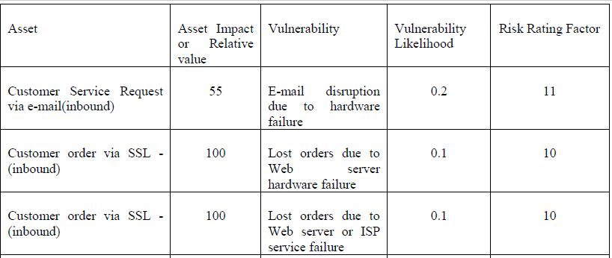
Worksheet Level 2

Slide 40
Risk control strategy
Acceptance
Mitigatation
Avoidance
Transference
Terminate

Slide 41
Accept control strategy
Is the choice to do nothing to protect a vulnerability and to accept the outcome of its explanation.
Acceptance is valid only when :
Determined the level of risk
Assessed the probability of attack
Estimated the potential damage that could occur from attacks
Performed a thorough cost benefit analysis
Decided that the particular function, service, information, or asset did not
justify the cost of protection

Slide 42
Mitigate control strategy
Mitigate control strategy attempts to reduce the impact caused by the exploitation of vulnerability through planning and preparation.
Mitigation begins with the early detection that an attack is in progress and the ability of the organization to respond quickly, efficiently and effectively.
There are three types of plan
Incident Response plan – Actions to take while incident is in progress
Disaster Recovery plan - Most common mitigation procedure
Business Continuity plan – Continuation of business activities

Slide 43
Incidence Response plan
It will be taken while the incident in progress.
This IRP Plan provides answers to questions such as
1. What do I do now?
2. What should the administrator do first?
3. Whom should they contact?
4. What should they document?
Ex. For example, a system’s administrator may notice that someone is copying information from the server without authorization, signaling violation of policy by a potential hacker or an unauthorized employee

Slide 44
Disaster Recovery Plan
It includes entire spectrum of activities used to recover from the incident.
Includes :
All preparations for the recovery process
Strategies to limit losses during the disaster
Detailed steps to follow when the smoke clears
The dust settles, or the
Floodwater recede.
DRP focuses more on preparations completed before and actions taken after the incident, whereas the IRP focuses on intelligence gathering, information analysis, coordinated decision making, and urgent, concrete actions.

Slide 45
Business Continuity Plan
BCP is the most strategic and long term of the three plans.
It encompasses the continuation of business activities if a catastrophic event occurs, such as the loss of an entire database, building or operations center.
BCP Includes:
Planning the steps necessary to ensure the continuation of the organization when the scope or scale of a disaster exceeds the ability of the DRP to restore operations.
Many companies offer this service as a contingency against disastrous events such as fires. Floods, earthquakes, and most natural disasters.

Slide 46

Defend control strategy
Defend control strategy attempts to prevent the exploitation of vulnerability.
This is the preferred approach and is accomplished by means of countering threats , vulnerabilities from assets , limiting access to asset and adding protecting
Common methods of Defend
Application of policy
Education and training
Application of technology

Slide 47
Transfer control strategy
It is an control approach that attempts to Shift the risk to other assets, other process , or other organizations
It may be accomplished through
Rethinking how services are offered
Revising deployment model
Purchasing Insurance
Outsourcing to other organization
Implementing Service contract
Information Security mistake made by individuals :
E.g. Password on post it notes, Leaving unattended computers on, Poor password, Plug & Play
Soln: Should hire an Quality Security Management and with admin experience.

Slide 48
Terminate
The terminate control strategy directs the organization to avoid those business activities that introduce uncontrollable risks.
By terminating the questionable activity, the organization reduces the risk exposure.
Eg., If an organization studies the risks from implementing business-to-consumer e-commerce operations and determines that the risks are not sufficiently offset by the potential benefits, the organization may seek an alternate mechanism to meet customer needs

Slide 49
Thank You

